Slide 1



Module 2. Lesson 3.
Memory Card
Application
Link to the training manual

Slide 2

Module 2. Lesson 3. Memory Card Application. P1
Discussion:
Memory Card Application

Slide 3
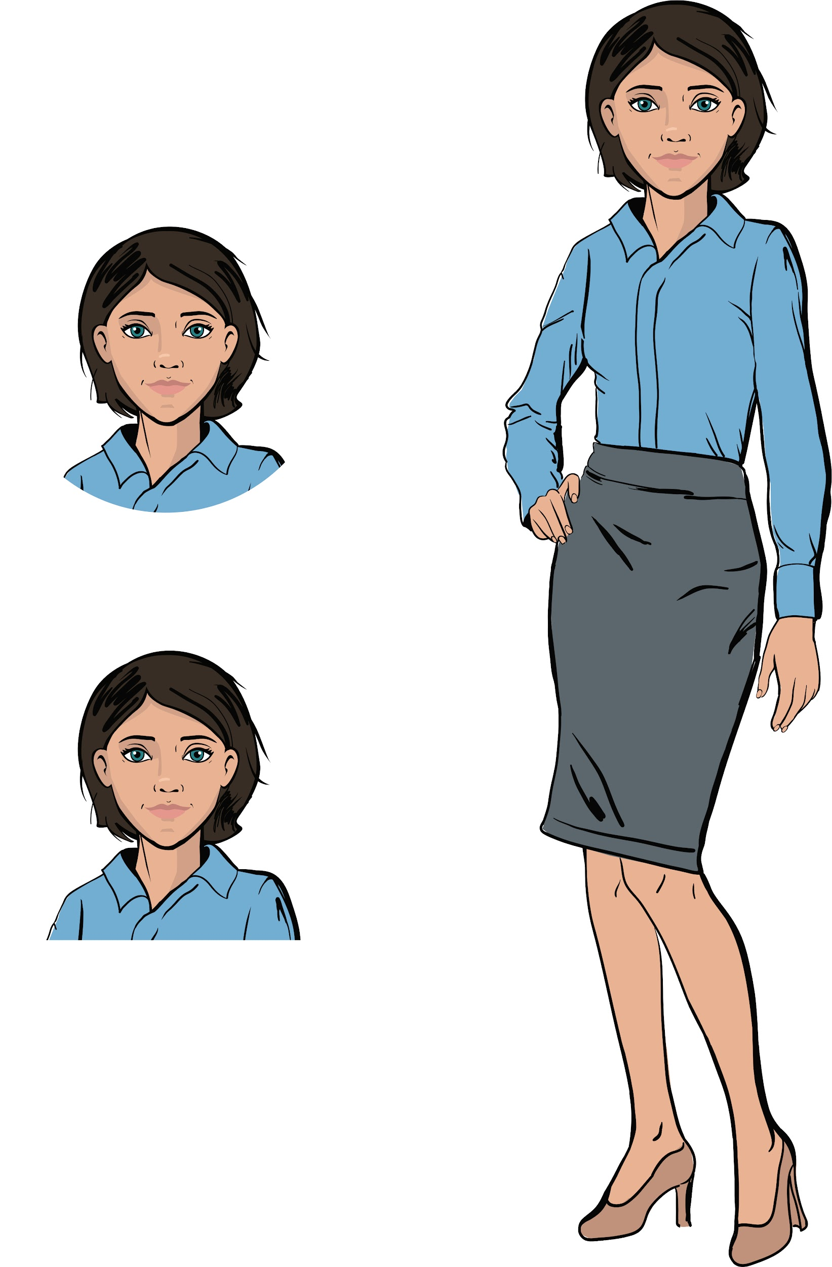

We’ve got a big order!
The ProTeam developers been contacted by the “Citizen of the World” cultural center.
To help their specialists memorize the cultures and languages of people all over the world, the cultural center has ordered a Memory Card application.
The application should ask multiple choice questions and determine whether the user answered correctly.
Ready to start?
Discussing the tasks
Emily,
Project manager

Slide 4
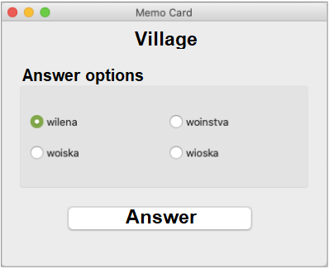
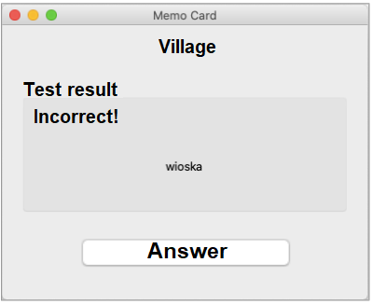

Let’s examine our task
Product type:
an application (for the computer)
Functionality:
asks a random question from a set; checks the answer
Discussing the tasks

Slide 5
Let’s examine our task
Product type:
application (for the computer)
Functionality:
asks a random question from a set; checks the answer
Discussing the tasks
What instruments will we need for this task?

Slide 6
Let’s examine our task
Memory Card Application
Application functionality
Application interface
Data structures for storing questions and answer options.
The random module for generating random question.
Question form with answer options.
Result form with correct answer displayed.
Buttons: “Answer” and “Next question.”
Replacing one question with another.
Discussing the tasks

Slide 7
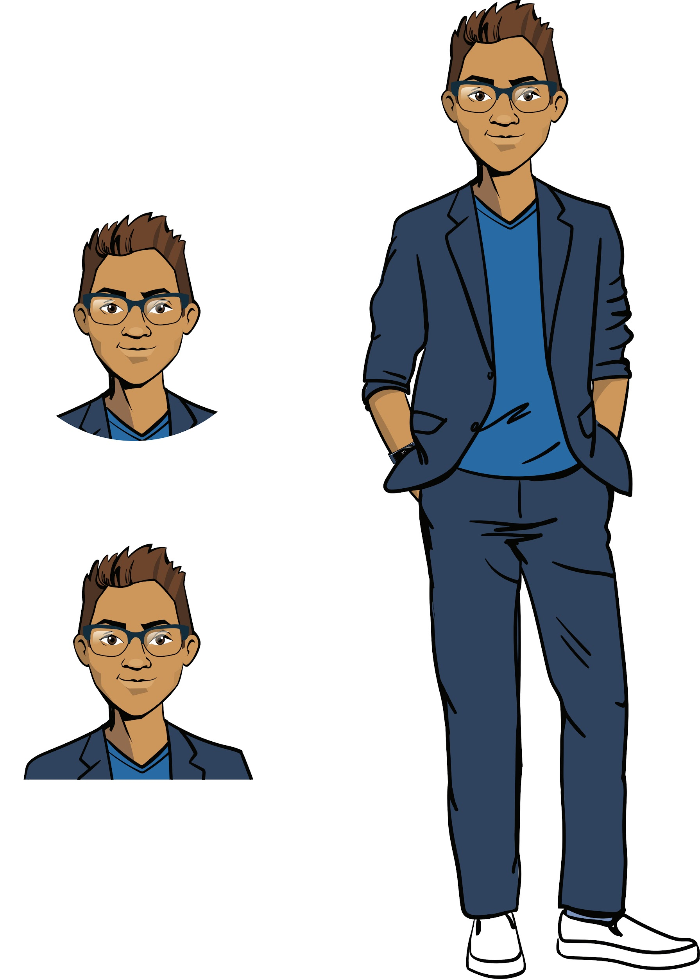
Memory Card Application
With some rare exceptions (for example, grouping radio buttons) there are no unfamiliar topics.
But this project will require the comprehensive use of various areas of programming.
Discussing the tasks

Slide 8
The goal for the workday —
Make a work plan for the Memory Card application and develop its interface.
Today you will:
Discussing the tasks
review the layouts and types of widgets, and how to program them using PyQt
learn new parameters for positioning content in the application window
create an interface for the Memory Card application

Slide 9

Module 2. Lesson 3. Memory Card Application. P1
Qualifications

Slide 10
Show off your knowledge
of the PyQt library
Qualifications

Slide 11
What is a windowed application?
What is it made up of?
Qualifications

Slide 12
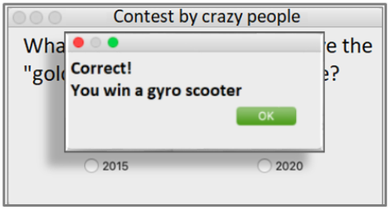
A windowed application
Is a computer program that interacts with a user through a graphical interface.
A standard windowed application is made up of:
a main window
control elements (widgets)
additional windows (optional)
Qualifications
Main window
Additional window
Widgets

Slide 13
What PyQt modules do you know? What are they used for?
Qualifications

Slide 14
Linking PyQt modules
QtCore
QtWidgets
. . .
Qt module:
constants and flags that determine the appearance of the window
Modules: QApplication, QWidget, QLabel, QVBoxLayout:
Widgets and their positioning
Qualifications
Must be linked for the alignment parameter
Must be linked for these widgets..
from PyQt5.QtCore import Qt
from PyQt5.QtWidgets import (
QApplication, QWidget, QLabel, QVBoxLayout, QHBoxLayout, ...
)

Slide 15
What widgets do you know?
How to create a(n):
radio button,
button,
label?
Qualifications

Slide 16
Popular widgets:
from PyQt5.QtCore import Qt
from PyQt5.QtWidgets import QApplication, QWidget, QPushButton, QLabel, QRadioButton
Object | Designation
Application | QApplication
Application window | QWidget
Label | QLabel
Button | QPushButton
Radio button | QRadioButton
Qualifications

Slide 17
What methods are used to create layouts?
To add widgets to layouts?
Qualifications

Slide 18
Positioning widgets in a line
Method | Designation
v_line = QVBoxLayout() | A constructor that creates an object of the type “Vertical line.”
v_line.addWidget( title, alignment = Qt.AlignCenter ) | A method that adds a widget to a line and centers it.
my_win.setLayout(v_line) | Add the resulting line and its objects to the application window.
Qualifications
A horizontal line is created the same way.
Layouts can be added to other layouts.

Slide 19
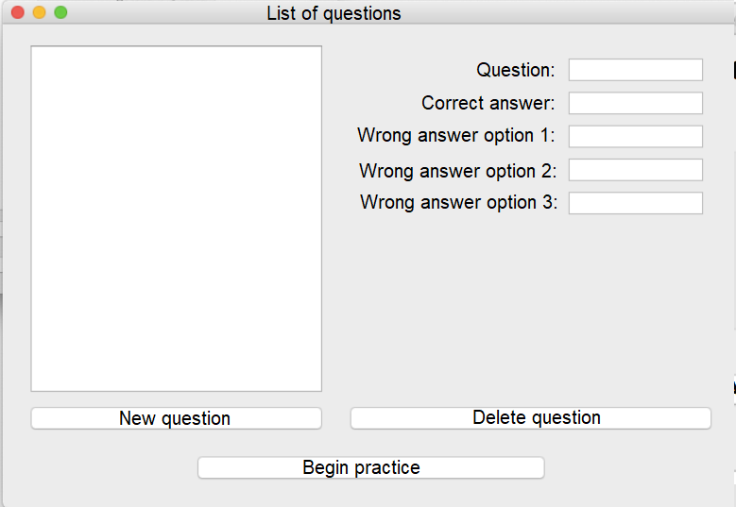
Name and show the guiding lines in this window:
Several correct answers are possible!
Review

Slide 20
Possible answer:
Several correct answers are possible!
Review

Slide 21
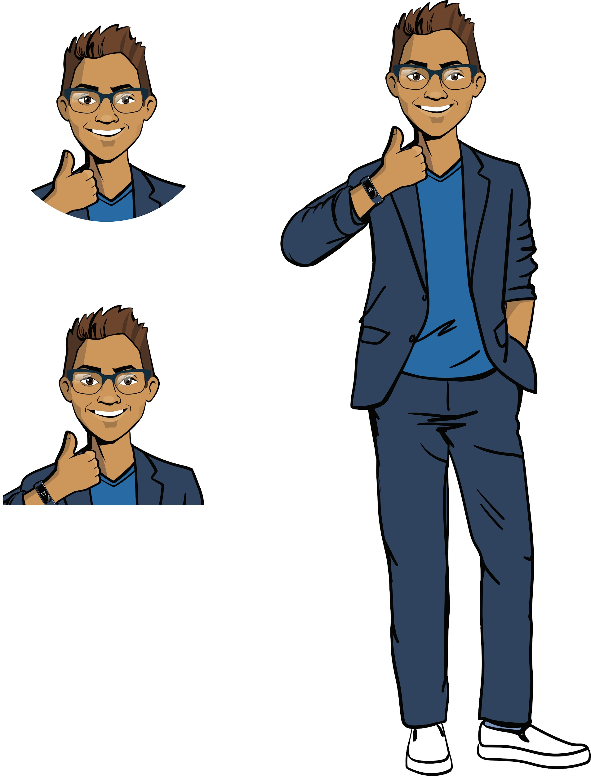
Qualification confirmed!
Excellent, you’re ready to brainstorming and carry out this job!
Qualifications

Slide 22

Module 2. Lesson 3. Memory Card Application. P1
Brainstorming:
The Memory Card Interface

Slide 23
Working on a large project
Memory Card is a big project that can’t be finished in one workday.
Before they start working on a large task, real designers split it into sub-tasks and come up with a work strategy.
Right now, we’re going to describe the expected functionality for Memory Card using a diagram, and plan our tasks for today.
Brainstorming

Slide 24
Application property diagram
Widget creation
Positioning in layouts
Main layout display
Widget creation
Positioning in layouts
Main layout display
Question form display
Answer form display
Memory Card
Question storage
Event handling
Question and answer structure
Storage for all questions
Random question display
Handling “Answer” button press
Handling option button press

Slide 25
Application property diagram
Создание виджетов
Расположение по лэйаутам
Отображение гл. лэйаута
Widget creation
Positioning in layouts
Main layout display
Отображение формы вопроса
Answer form display
Memory Card
Current task
Question storage
Event handling
Question and answer structure
Storage for all questions
Random question display
Handling “Answer” button press
Handling option button press

Slide 26
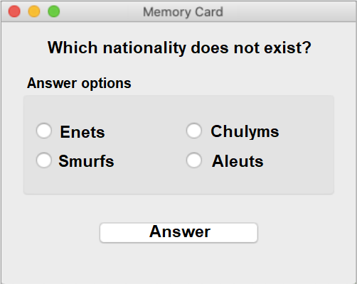
What widgets are in this window?
QLabel()
QRadioButton()
Brainstorming
?
?

Slide 27
What widgets are in this window?
QLabel
QRadioBox
Brainstorming
QGroupBox (?)
QPushButton

Slide 28
The QGroupBox Group (QtWidgets)
Method | Designation
RadioGroupBox = QGroupBox(‘Options’) | Constructor for creating a group (visibly separate)
rbtn_1 = QRadioButton('Enets') layout_quest = QHBoxLayout() layout_quest.addWidget(rbtn_1) | Create radio buttons, create line layout, add radio button to layout
RadioGroupBox.setLayout(layout_quest) | Make the layout the content of the group
Brainstorming

Slide 29
RadioGroupBox = QGroupBox("Answer options")
rbtn_1 = QRadioButton('Enets')
rbtn_2 = QRadioButton('Smurfs')
rbtn_3 = QRadioButton('Chulyms')
rbtn_4 = QRadioButton('Aleuts')
layout_ans1 = QHBoxLayout()
layout_ans2 = QVBoxLayout()
layout_ans3 = QVBoxLayout()
layout_ans2.addWidget(rbtn_1)
layout_ans2.addWidget(rbtn_2)
layout_ans3.addWidget(rbtn_3)
layout_ans3.addWidget(rbtn_4)
layout_ans1.addLayout(layout_ans2)
layout_ans1.addLayout(layout_ans3)
RadioGroupBox.setLayout(layout_ans1)
Brainstorming

Slide 30
How is this content positioned in the layout?
Brainstorming

Slide 31
One possibility:
4
1
2
A group of widgets with a given layout
Brainstorming
3

Slide 32
Another possibility:
Layout line 1
Brainstorming
Layout group 2
Layout line 3

Slide 33
Another possibility:
Main vertical layout
Layout line 1
Brainstorming
Layout group 2
Layout line 3

Slide 34
Widget placement (QtCore)
Command | Designation
alignment=Qt.AlignHCenter alignment=Qt.AlignVCenter | Align to center (horizontally) Align to center (vertically)
stretch=2 | Stretch a widget (for example, a button)
Brainstorming
stretch=1
stretch=3

Slide 35
Widget placement
Command | Designation
alignment=Qt.AlignHCenter alignment=Qt.AlignVCenter | Align to center (horizontally) Align to center (vertically)
stretch=2 | Stretch a widget (for example, a button)
layout_card.setSpacing(5) | Set spacing between content in the layout (for example, between horizontal lines)
Brainstorming

Slide 36
Example:
Command | Designation
alignment=Qt.AlignHCenter | Align to center
stretch=2 | Stretch a widget (button)
layout_card.setSpacing(5) | Set spacing between lines
Brainstorming
layout_line1.addWidget(lb_Question, alignment=Qt.AlignHCenter)
#...
layout_line3.addWidget(btn_OK, stretch=3)
#...
layout_card.setSpacing(5)
Question in the center, large “Answer” button,
there is spacing between question, answers and button.

Slide 37
Your goal:
Begin creating an interface for the Memory Card application in the development environment.
Create an application window; set sizes; heading.
Create a question display form:
link the necessary modules
create the necessary widgets
position these widgets in layouts
set spacing and center content where needed
Brainstorming

Slide 38
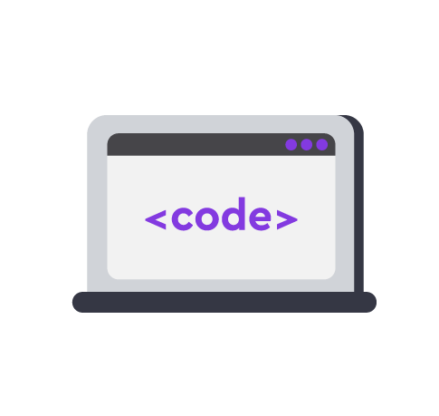
Module 2. Lesson 3. Memory Card Application. P1
Visual Studio Code:
Memory Card Application

Slide 39


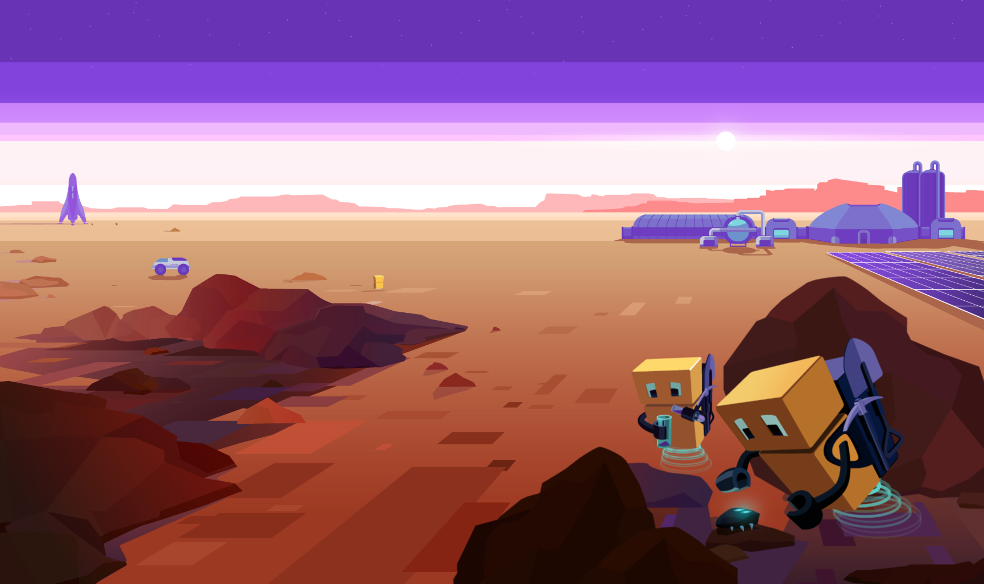
Do the task in VS Code
«VSC. PyQt. Memory Card»
Visual studio code от «Algorithmics»
Application creation

Slide 40
Module 2. Lesson 3. Memory Card Application. P1
Brainstorming:
The Memory Card Interface

Slide 41
Application property diagram
Widget creation
Positioning in layouts
Main layout display
Создание виджетов
Расположение по лэйаутам
Отображение гл. лэйаута
Question form display
Отображение формы ответа
Memory Card
Current task
Question storage
Event handling
Question and answer structure
Storage for all questions
Random question display
Handling “Answer” button press
Handling option button press

Slide 42
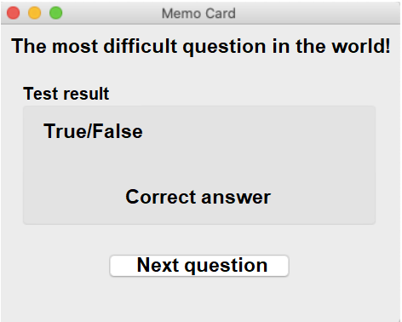
What widgets are in this window?
?
?
?
Brainstorming
?

Slide 43
What widgets are in this window?
QLabel
QGroupBox
QLabel
Brainstorming
QPushButton

Slide 44
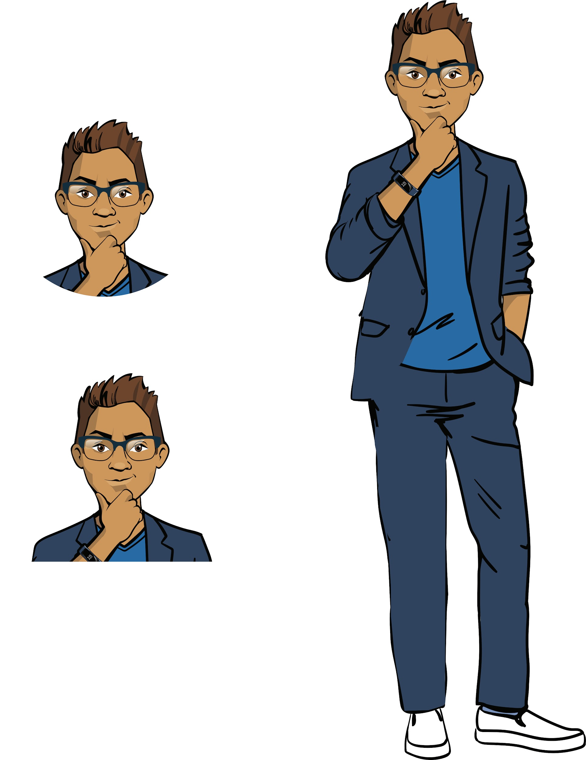
Switching from form to form
Optimally, both the question form and the answer form should be placed in the same window.
In that case, the switch from the question form to the answer form will happen when the “Answer” button is pressed.
We’ll do event handling next time. For now, let’s hide the question form and put the correct answer form above it.
Brainstorming

Slide 45
Show/hide group
You already know the commands for covering and displaying widgets. You can hide and show groups of widgets the same way.
Command | Designation
RadioGroupBox.hide() | Cover answer option panel
AnsGroupBox.show() | Show correct answer panel (shown by default)
Brainstorming

Slide 46
How do we position the content in the layouts?
Brainstorming

Slide 47
One possibility:
Lines of text formatted as a group.
Brainstorming

Slide 48
Another possibility:
Layout line 1
Line group 2
Brainstorming
Layout line 3

Slide 49
Another possibility:
Main vertical layout
Brainstorming

Slide 50
Your task:
Continue creating the interface for the Memory Card application in the development environment.
Hide the question and answer option form.
Create the correct answer form:
link the necessary modules
create the necessary widgets
place them in the layouts
set spacing and center content where needed
Brainstorming

Slide 51
Module 2. Lesson 3. Memory Card Application. P1
Visual Studio Code:
Memory Card Application

Slide 52
Do the task in VS Code
«VSC. PyQt. Memory Card»
Visual studio code от «Algorithmics»
Application creation

Slide 53

Module 2. Lesson 3. Memory Card Application. P1
Wrapping up the workday

Slide 54

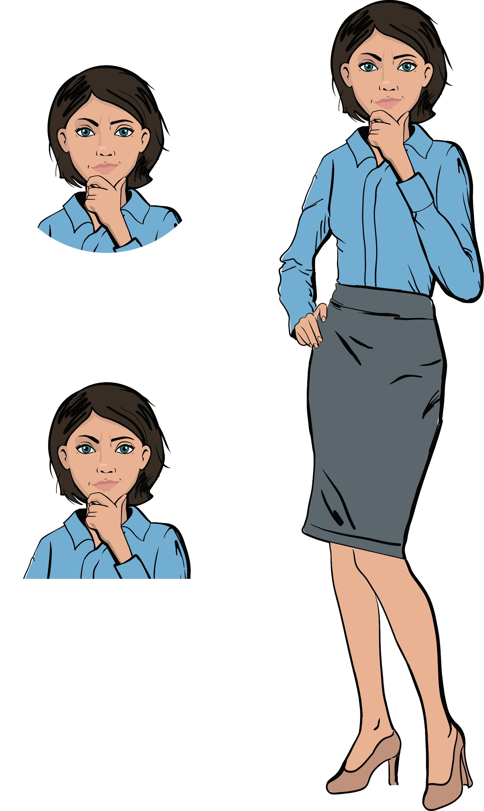
To wrap up the workday, complete a technical interview:
List all the possible objects that can be added to the layout.
How do you center a widget? How do you align it to the left? What module needs to be linked for that?
How do you stretch a widget? What module needs to be linked for that?
Wrapping up the workday
Cole,
Senior developer
Emily,
Project manager

Slide 55
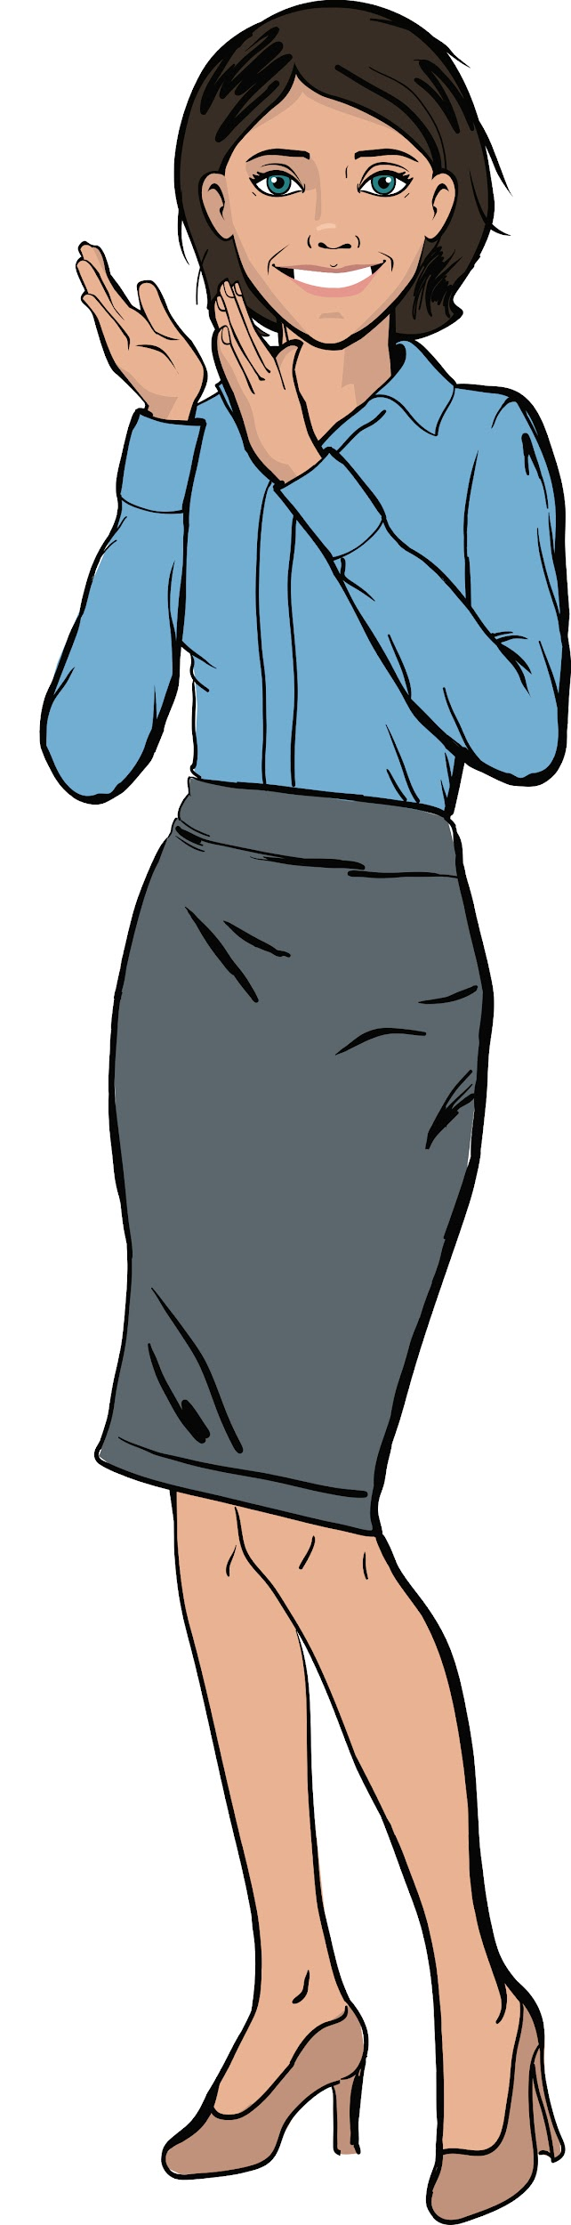
Excellent work!
Today, you:
began working on a large project and broke it into tasks
completed two blocks of tasks for programming the interface
learned new parameters for aligning and stretching widgets
Wrapping up the workday

Slide 56
Evaluating the effectiveness of today’s work
Answer these questions with your colleagues:
What went especially well today?
What didn’t turn out the way you wanted?
What should you do next time to ensure a success?
Wrapping up the workday

Slide 57
Additional tasks
Examine the code you’ve written one more time.
Finish writing the code, if necessary.
Add additional comments to the code to explain
which part of the code does what.
Wrapping up the workday

